Slide 1


Making Sense of Sounds: Machine Listening in the Real World
Mark Plumbley
Centre for Vision, Speech and Signal Processing (CVSSP) University of Surrey
WASPAA 2017, 18 October 2017

Slide 2
Many thanks to …
Christian Kroos
Sacha Krstulovic
Jason Nurse
Sid Sigtia
Iwona Sobieraj
Dan Stowell
Wenwu Wang
Yong Xu
and many others…
Daniele Barchiesi
Emmanouil Benetos
Olly Bones
Trevor Cox
Bill Davies
Peter Foster
David Frohlich
Dimitrios Giannoulis
Qiang Huang
Qiuqiang Kong
And thanks to funders: EPSRC, Leverhulme Trust, EU Framework 7 & H2020, Innovate UK, ...

Slide 3
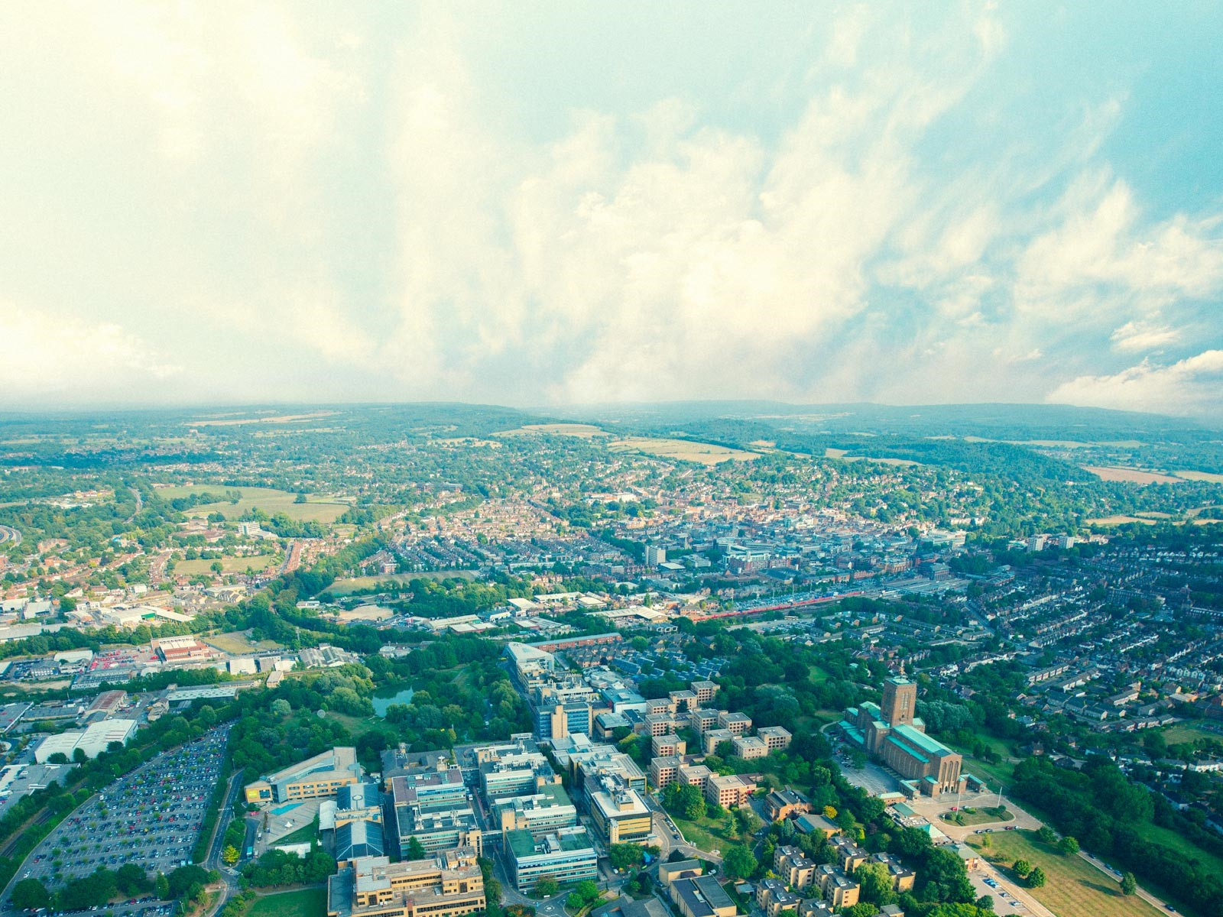
University of Surrey

Slide 4
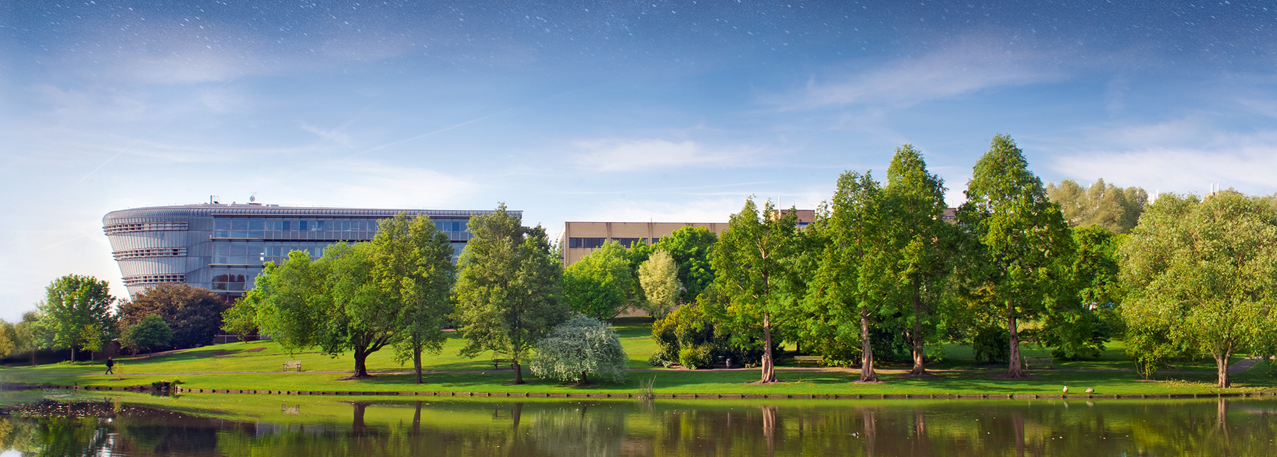

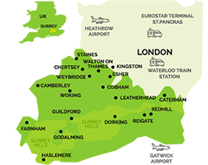
15,000 students
In Guildford, County of Surrey, South East England, UK
40 mins from London
Close to Heathrow & Gatwick Airports
Next to “Surrey Hills” Area of Outstanding Natural Beauty

Slide 5




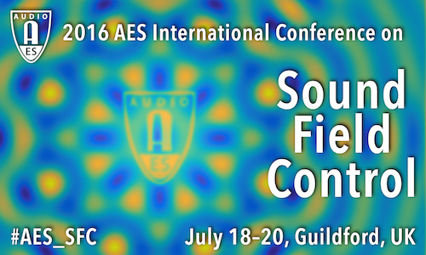
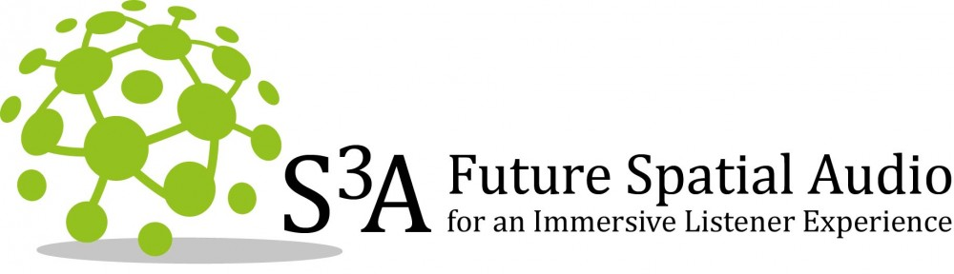
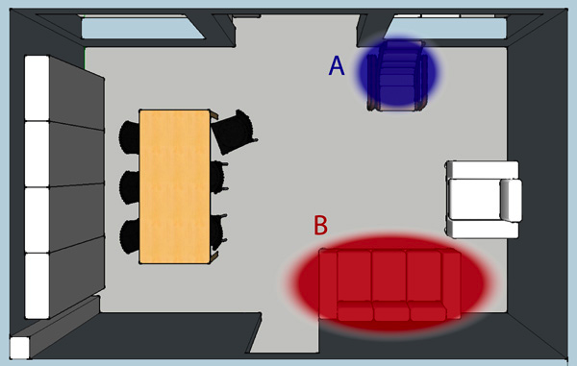
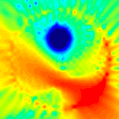
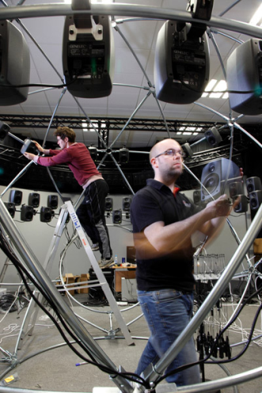
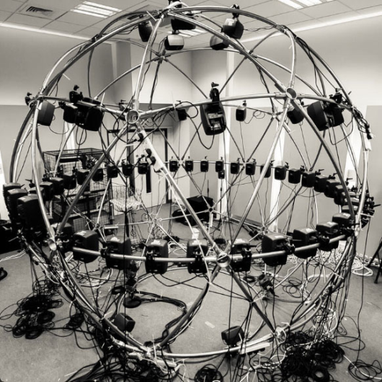
Audio Research at Surrey
CVSSP
Centre for Vision, Speech and Signal Processing
Centre for Vision, Speech and Signal Processing (CVSSP)
Technologies for machine perception of audio scenes
Institute of Sound Recording (IoSR) Research into human perception of audio quality
Digital World Research Centre (DWRC) Design of digital technologies
Centre for Digital Economy (CoDE) New business models enabled by digital technology

Slide 6
LVA ICA 2018
14th International Conference on Latent Variable Analysis and Signal Separation
July 2-6, 2018 University of Surrey, Guildford, UK
Paper deadline: January 15, 2018
cvssp.org/events/lva-ica-2018

Slide 7
Outline
Introduction
Data and Data Challenges
Algorithm Performance vs Computation
Adventures with Deep Learning
Classes hierarchy
Spatial features
Weakly labelled data
Privacy: Are your devices listening to you?
Conclusions

Slide 8
Introduction: Machine Listening
Sounds: events, environment, alarms, medical, …
Sound as content (e.g. music, broadcast speech)
Sound as information (e.g. monitoring, communication)
Many new directions, e.g.:
Security (home, professional): glass break, shouts
“Legacy IoT”: monitoring sound-emitting devices
Assisted living: activity sounds, assistance calls
Environmental monitoring: birds, insects, logging
Medical sounds: heart, lungs
Multimedia video+sound indexing, tagging

Slide 9
Audio Event Detection
[Figure: Tuomas Virtanen]

Slide 10
Audio Scene Classification
[Figure: Tuomas Virtanen]

Slide 11

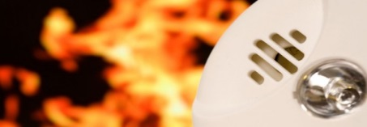
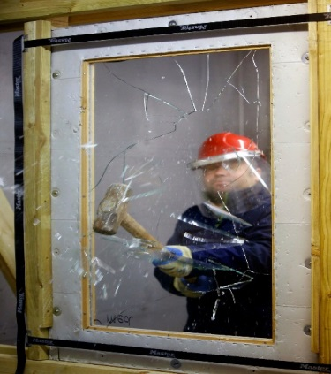


Application Examples: Professional Security & Connected Home
Advanced Smart Microphone - Portable wireless audio sensor: “Internet of Sensors” detect sounds and analyse audio scenes
Audio Data Exploration: Professional/home security, multimedia database indexing, industrial/environmental monitoring
Glass breaks, smoke alarms, gun shots, car alarms, baby cries, …
Collaboration with SME Audio Analytic
Funding: Innovate UK, EPSRC, Audio Analytic
Photo: Audio Analytic
Photo: Audio Analytic

Slide 12
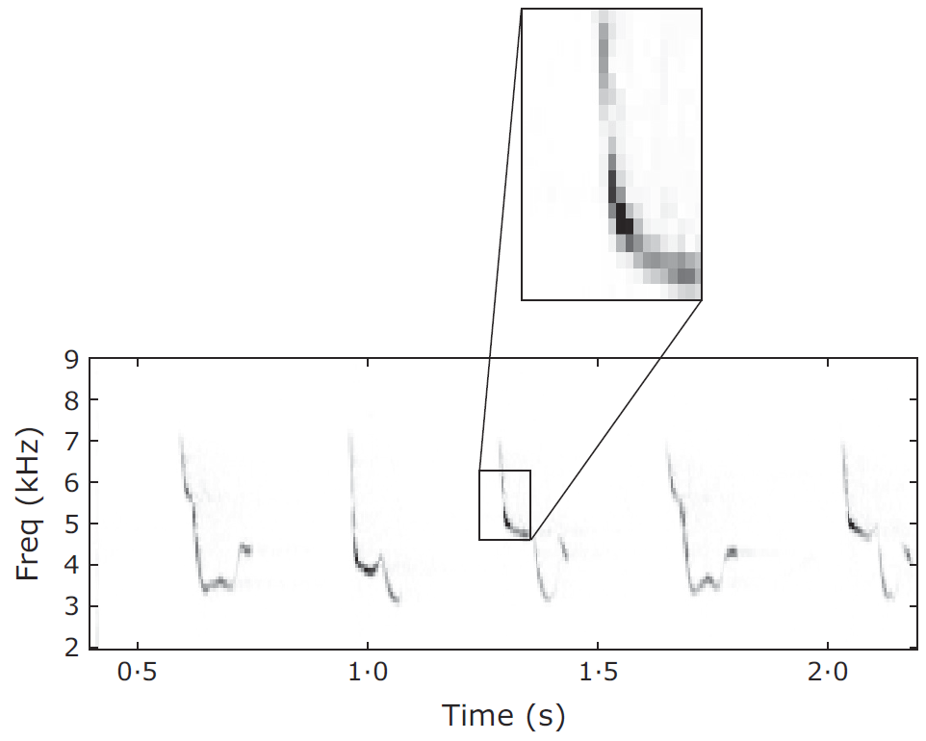
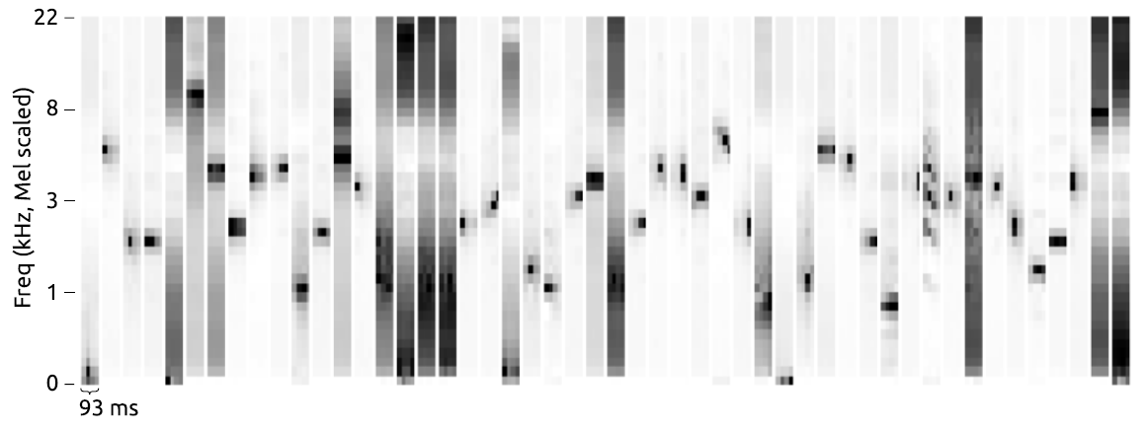
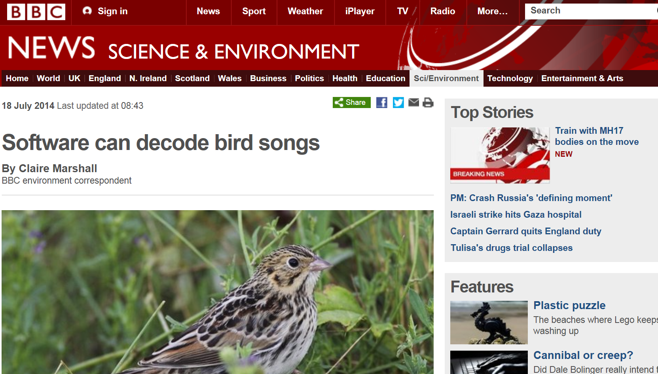
Application Examples: Birdsong Identification
With: Stowell
Strong frequency modulation (FM)
Addition of FM features help species recognition
Unsupervised feature learning gives boost vs MFCCs, Mel spectra
Best audio-only system (MAP 42.9%) in LifeCLEF 2014 bird identification challenge (501 classes, 9688 items)
Press interest (including Twitter, of course!)
Led to “Warblr” App (Stowell, Wilkinson) and Bird Audio Detection challenge

Slide 13
Data and Data Challenges

Slide 14
Why Data Challenges?
Huge potential for automatic recognition of real-world sounds
Until recently: relatively little research activity, compared to e.g. image, speech, or even music
Barrier? -> Shortage of good open datasets for research
Data is expensive/time-consuming to collect and label
Commercial data may be restricted, hard to compare
Public evaluation data challenges: (1) Provide open data that researchers can use (2) Encourage reproducible research (3) Attract new researchers into the field (4) Create reference points for performance comparisons

Slide 15
Example data challenges
Some earlier evaluation challenges, e.g.:
MIREX: Music Information Retrieval (since 2005/6)
PASCAL CHiME: Speech Separation (since 2006)
CHIL CLEAR: AV from meetings (2007-8)
SiSEC: Source Separation (since 2008)
TRECVID Multimodal Event Detection (since 2010/11)
IEEE Audio & Acoustics Sig Proc (AASP) TC support, e.g.:
CHiME 2, REVERB, ACE, …

Slide 16

Detection and Classification of Acoustic Scenes and Events (DCASE 2013)
With: Giannoulis, Stowell, Benetos, Barchiesi, Rossignol, Lagrange
Acoustic scene classification + acoustic event detection
Scene Classification:
busy street, quiet street, supermarket/store, restaurant, office, park, bus, tube/metro, tubestation, open market
Event Detection – (a) Office Live, (b) Office Synthetic
door knock, door slam, speech, laughter, clearing throat, coughing, drawer, printer, keyboard click, …
See: http://c4dm.eecs.qmul.ac.uk/sceneseventschallenge/

Slide 17
Timeline
Apr/May 2012: Proposed/accepted by IEEE AASP TC
Jun 2012: Initial recordings; WASPAA Special Session agreed
Jul 2012: Call for participation
Summer 2012: Community discussion, recordings
Nov-Dec 2012: Check for recording quality
Dec 2012: Public release of training/development datasets
Jan 2013: Create virtual disk image, final task spec
Feb 2013: Submit EUSIPCO paper on task and baseline systems
Apr 2013: Code submission deadline
Apr-May 2013: Run code submissions, liaise with authors
May 2013: Results released privately to authors
Jun 2013: Submit WASPAA paper
Oct 2013: Public presentation and special session at WASPAA 2013
Oct 2015: Journal paper on Challenge in IEEE Trans Multimedia
Most popular paper of TMM for 16 of last 18 months

Slide 18
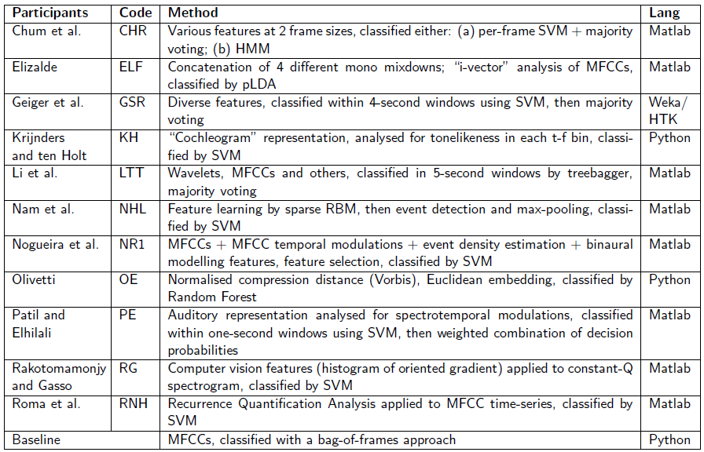
Submitted methods for scene classification …
Scene Classification Systems

Slide 19
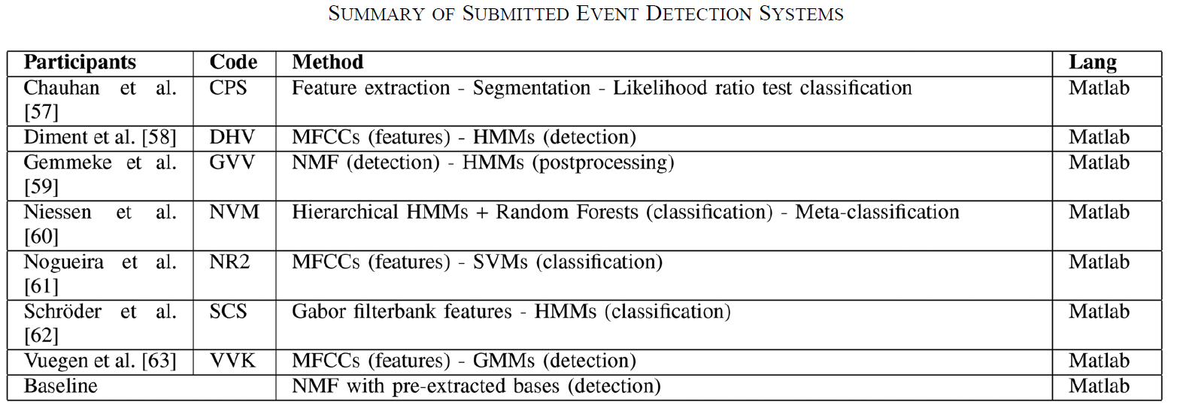
… and for event detection

Slide 20
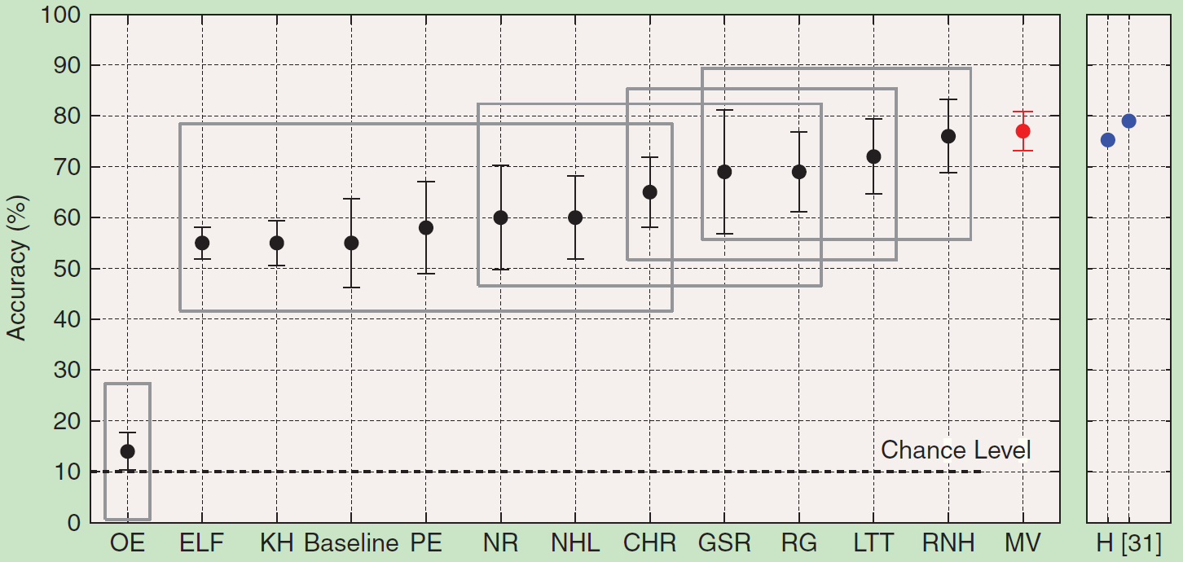
Results (Scene Classification)
Human
Most systems > baseline, some approach human performance
MV = Majority Vote
Participants encouraged to release software (6 released)
[Barchiesi, Giannoulis, Stowell, P, 2015] [Stowell, Giannoulis, Benetos, Lagrange, P, 2015]

Slide 21
DCASE 2013 outcomes
DCASE 2013 challenge and workshop led to
follow-up discussions between the teams,
both at WASPAA 2013 and later conferences
Recognition of interest in topic
Ideas for follow-up challenge: DCASE-2 (2016)
Search for other data sources…

Slide 22
CHiME-Home: Domestic Audio Tagging
With: Peter Foster, Siddharth Sigtia, Sacha Krstulovic, Jon Barker
What about “Smart Home” applications?
Need data from home environment
Opportunity: CHiME Challenge domestic “background noise” (designed for noisy speech recognition)
Developed with partner Audio Analytic
[Figure: Tuomas Virtanen]
[Foster, Sigtia, Krstulovic, Barker, P, WASPAA 2015]

Slide 23
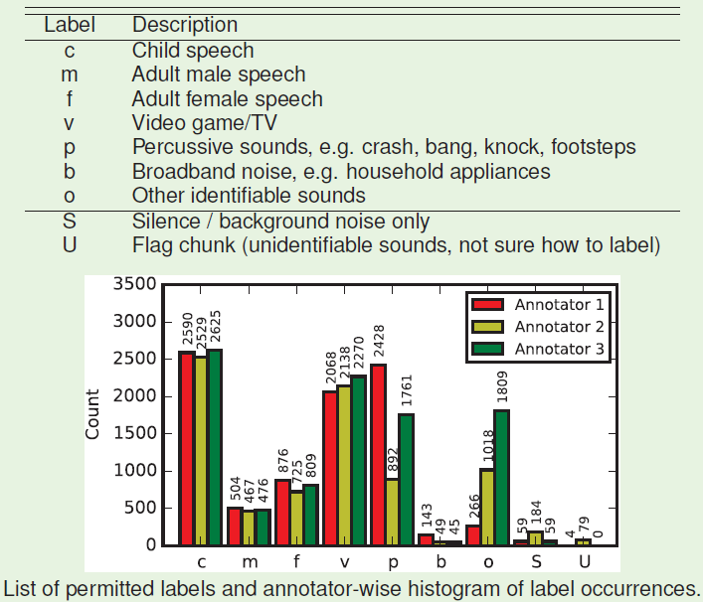
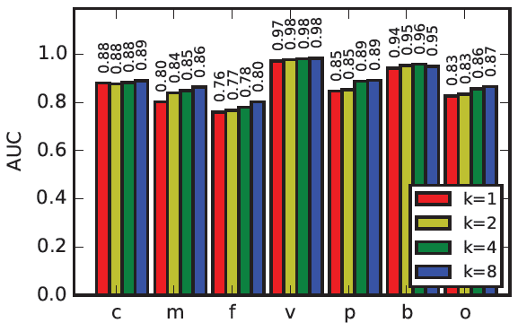
CHiME-Home Dataset
Recordings (7 hours) from domestic home
Audio: Background noise from CHiME Challenge [Barker et al, 2013]
Annotated in 4-sec chunks by 3 labellers
Tough annotation job: 2/3 annotators agree for only 45% of chunks.
Baseline: 0.76 - 0.98 AUC (MFCC+GMM)
Designed to be part of a data challenge…
Dataset URL: http://archive.org/details/chime-home

Slide 24
DCASE 2016: Data Challenge and Workshop
With: Annamaria Mesaros, Toni Heittola, Tuomas Virtanen,
Emmanouil Benetos, Peter Foster, Mathieu Lagrange
Build on and extend success of DCASE 2013
More data, more complex, closer to real applications
Four Tasks:
Task 1: Acoustic scene classification
Audio environment, e.g. "park", "street", "office"
Task 2: Sound event detection in synthetic audio
Office sound events, e.g. “coughing”, “door slam”
Task 3: Sound event detection in real life audio
Events in Home (indoor) and Residential area (outdoor)
Task 4: Domestic audio tagging (CHiME-Home)
Activity in the home, e.g. “child speech”, “TV/Video”

Slide 25
DCASE 2016: A Team Effort
International organizing team:
Tampere University of Technology (FI)
Queen Mary University of London (UK)
IRCCYN (FR)
University of Surrey (UK)
DCASE 2016 Workshop
Satellite workshop to EUSIPCO, Budapest, Sep 2016
23 Papers submitted to workshop

Slide 26
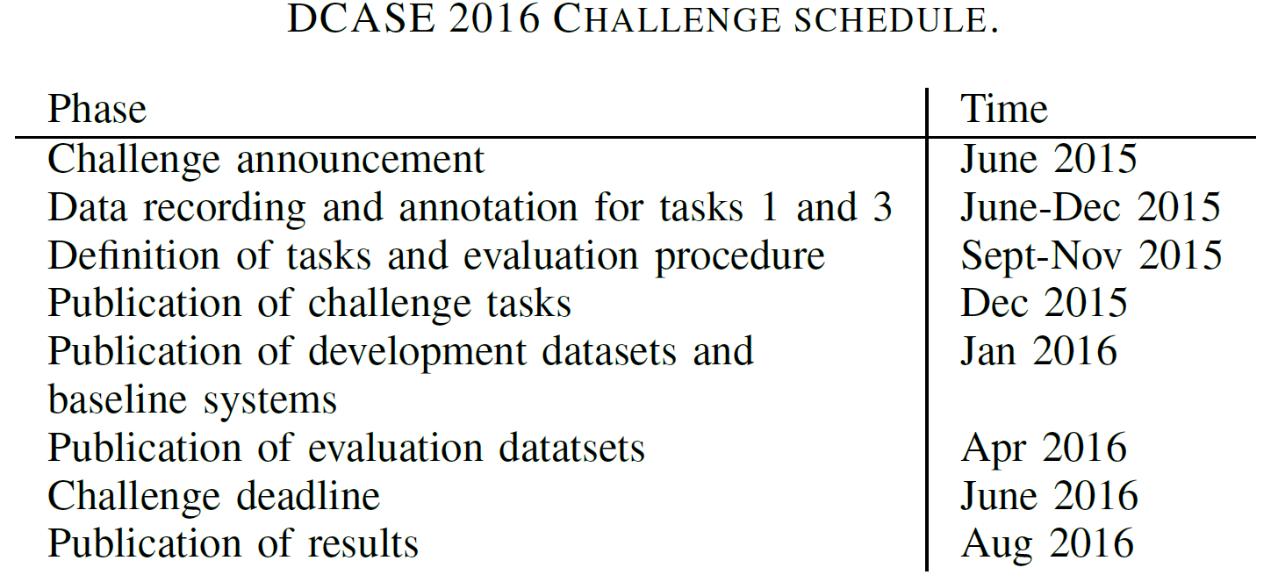
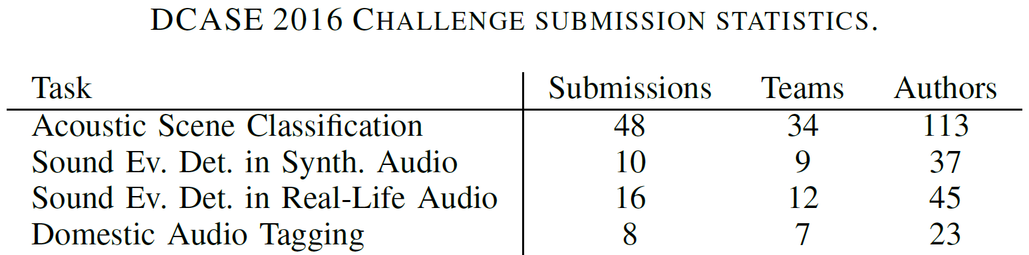
DCASE 2016: Timeline & Submissions
[Mesaros, Heittola, Benetos, Foster, Lagrange, Virtanen, P, 2017]

Slide 27
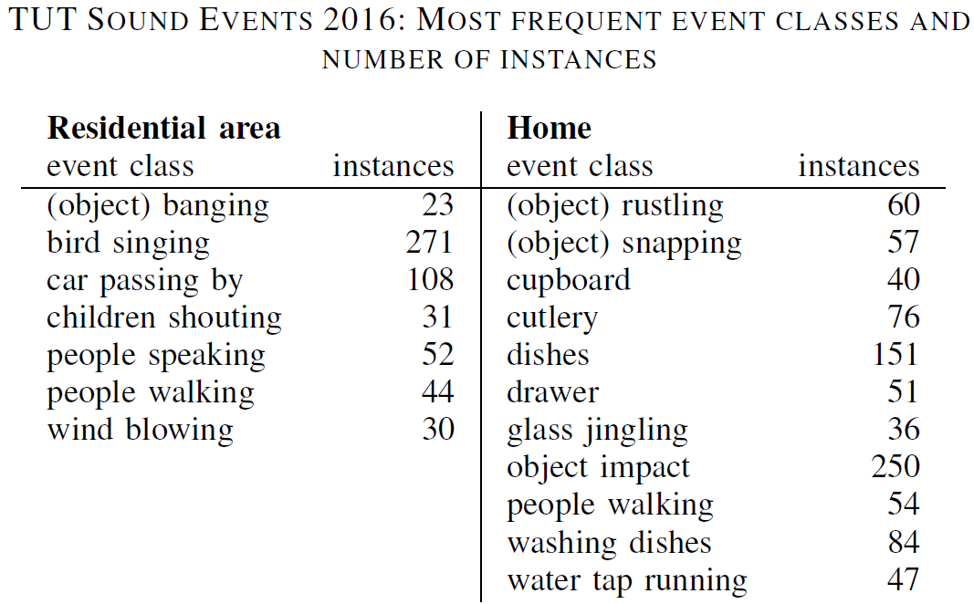
Some Issues: Data Class Imbalance
In Residential Area task:
Can get good performance by only recognizing “Bird Singing” and “Car Passing By” classes
Challenge: How to evaluate with unbalanced datasets?

Slide 28
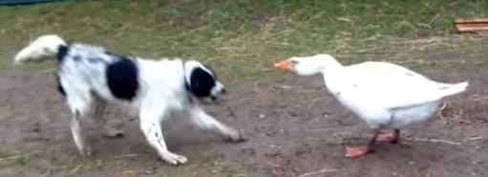
More recent datasets and challenges
Audio Set
From YouTube videos: 1,789,621 x 10-sec segments
Labelled with 632 audio event categories (hierarchical)
C.f. ImageNet for images, Million Song Dataset for music
DCASE 2017 Workshop: 16-17 Nov 2017, Munich, Germany
Task 1: Acoustic scene classification
Task 2: Detection of rare sound events
Task 3: Sound event detection in real-life audio
Task 4: Large-scale weakly supervised sound event detection for smart cars
http://www.cs.tut.fi/sgn/arg/dcase2017/

Slide 29
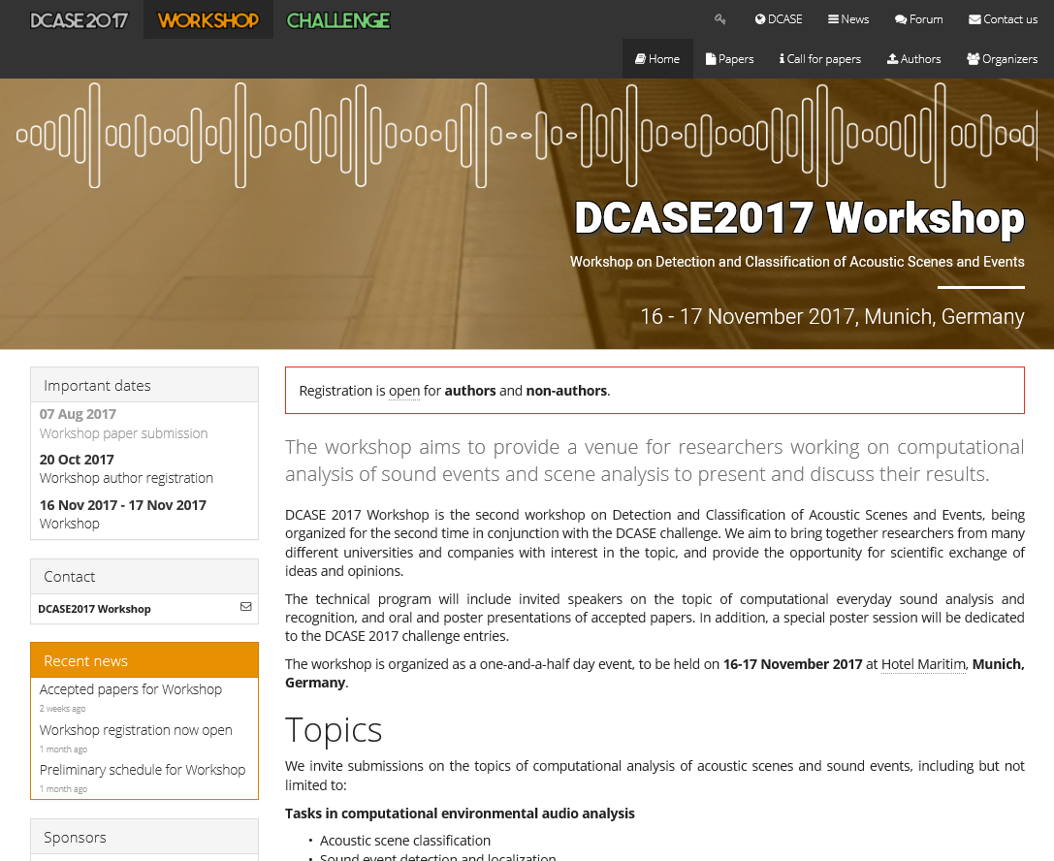

Slide 30
Algorithm Performance vs Computation Cost

Slide 31
Sound recognition in the Internet of Things
With: Siddharth Sigtia, Adam Stark, Sacha Krstulovic
IoT – Small devices, limited computation / memory
Signal Processing “on the edge”
Best Performance vs Computational Cost?
Gaussian Mixture Models?
Support Vector Machines?
Deep Neural Network?
Explore on example audio event datasets:
Baby Cry
Smoke Alarm
Use: Mel-frequency cepstral coefficient (MFCC) features
Train on 2000 examples in each dataset

Slide 32
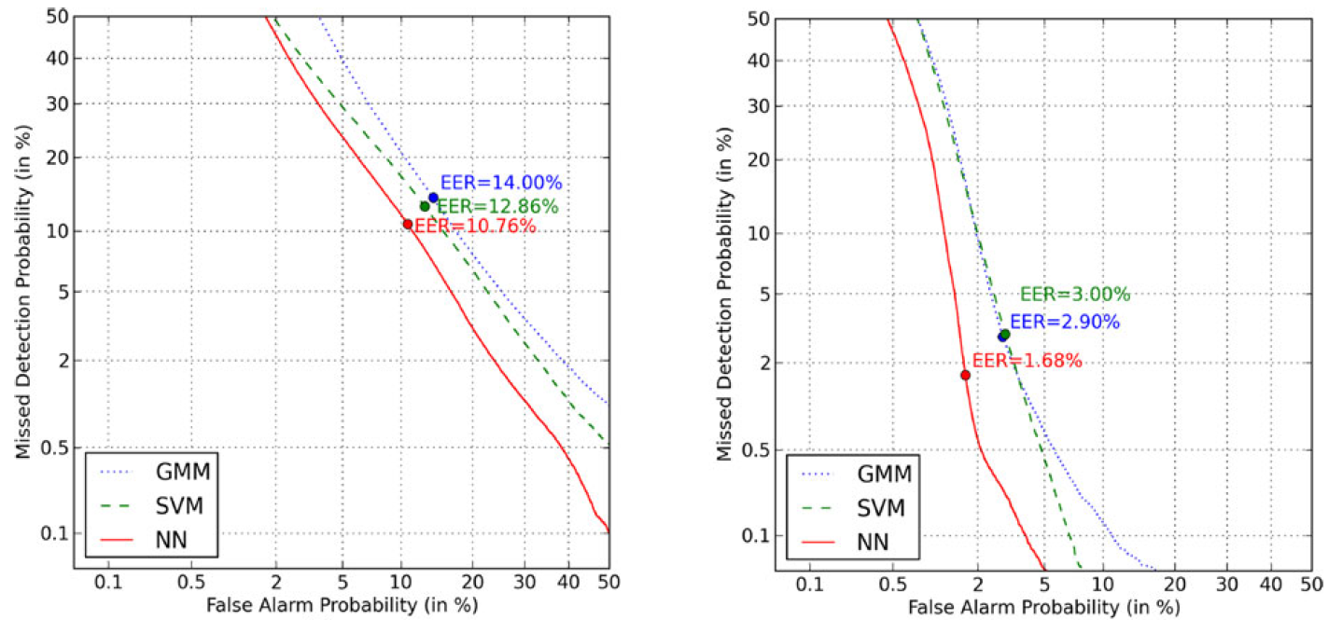
Performance: Detection Error Tradeoff (DET)
Baby Cry
Smoke Alarm
EER = Equal Error Rate

Slide 33
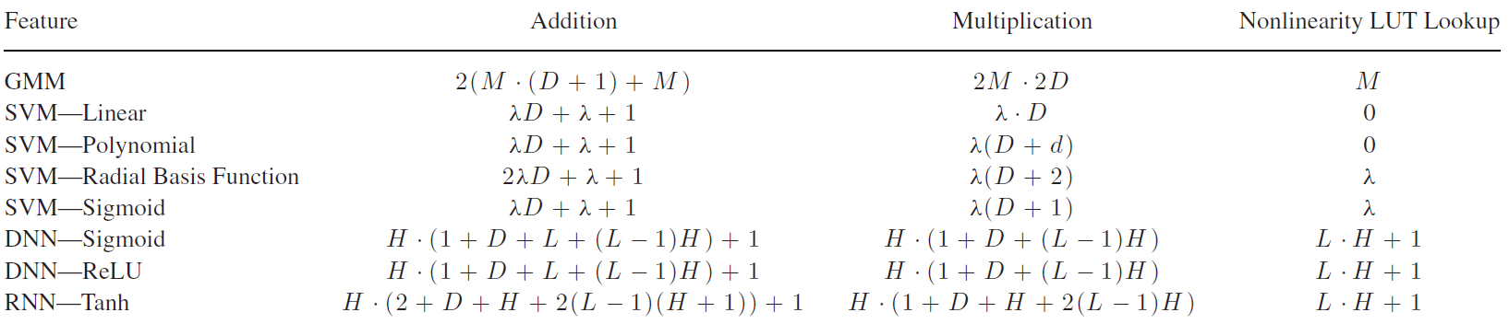
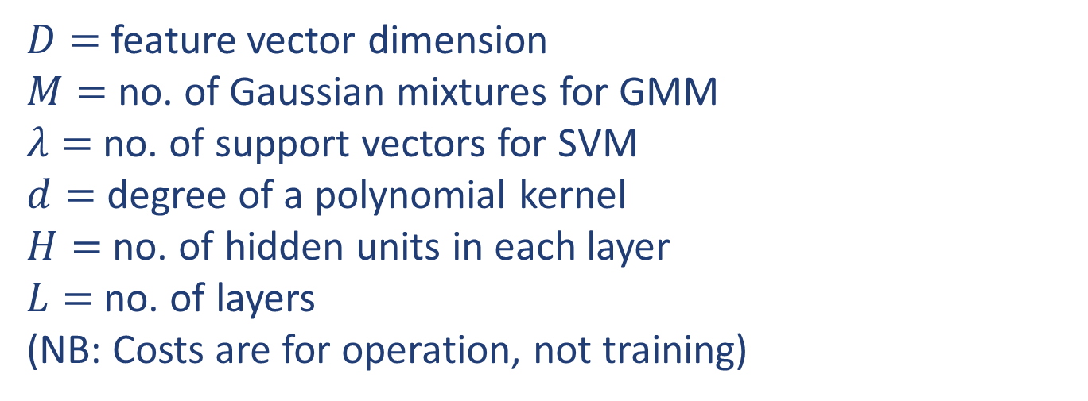
Computational Cost? Operations per Frame
$D=$feature vector dimension
$M=$no. of Gaussian mixtures for GMM
$λ=$ no. of support vectors for SVM
$d=$ degree of a polynomial kernel
$H=$ no. of hidden units in each layer
$L=$ no. of layers
(NB: Costs are for operation, not training)

Slide 34
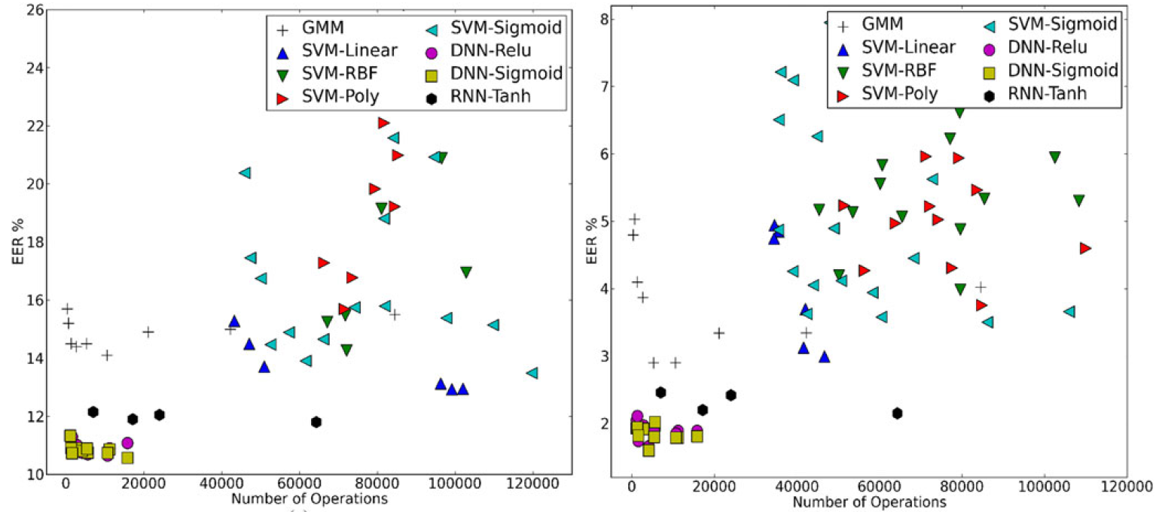
Performance vs number of operations
Baby Cry
Smoke Alarm
GMMs give reasonable low-cost baseline
SVMs similar performance to GMM, but more costly
DNNs very promising (deeper give better performance)
ReLU DNNs similar to sigmoid, simpler hardware (no LUT)

Slide 35
Adventures with Deep Neural Networks

Slide 36
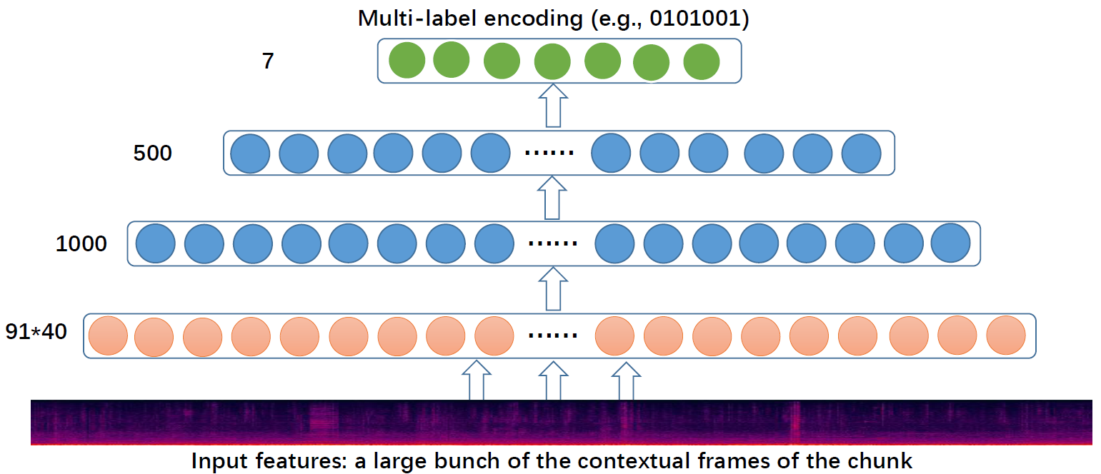
Pyramid Deep Learning structure
With: Xu, Huang, Kong, Wang, Foster, Sigtia, Jackson
Task: CHiME-Home (Domestic audio tagging)

Slide 37
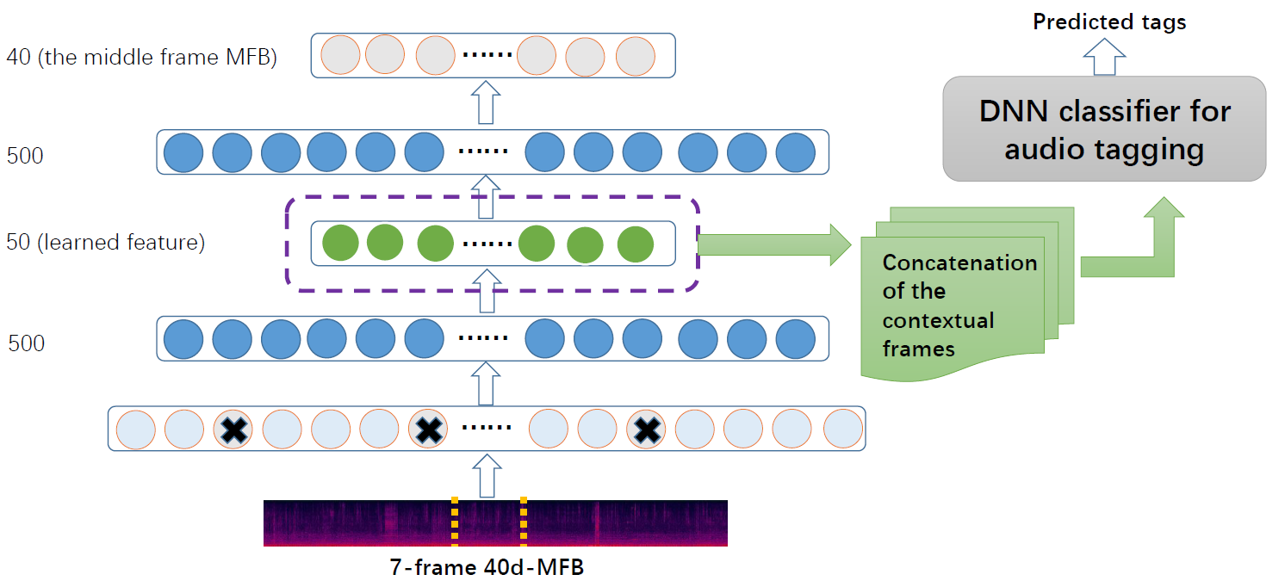
Asymmetric Deep Audio Encoder (asyDAE)
Trained to reconstruct middle frame only, not entire input
Dropout used (examples indicated by “x”)
[Xu, Huang, Wang, Foster, Sigtia, Jackson, P, T-ASLP, 2017]

Slide 38
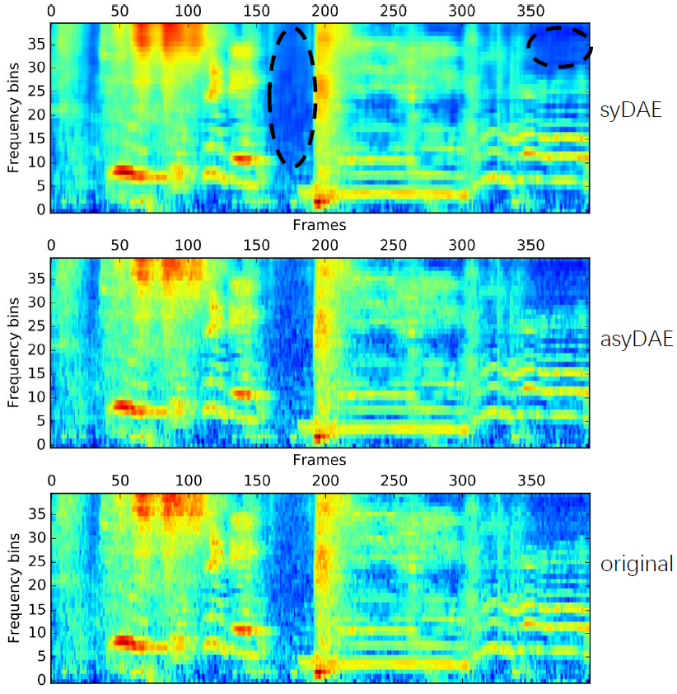
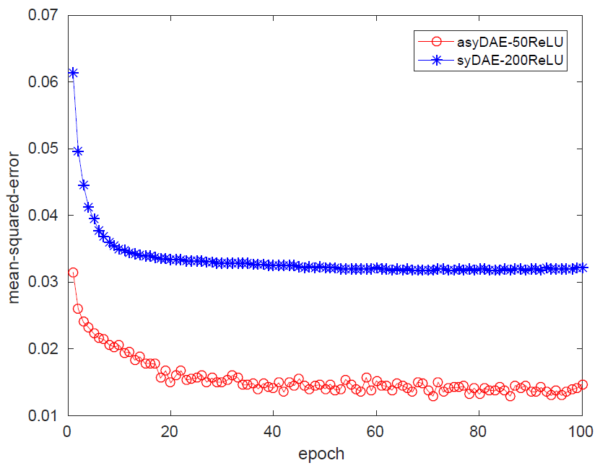
asyDAE: Reconstruction error
Symmetric Audio Encoder tends to smooth noisy regions

Slide 39
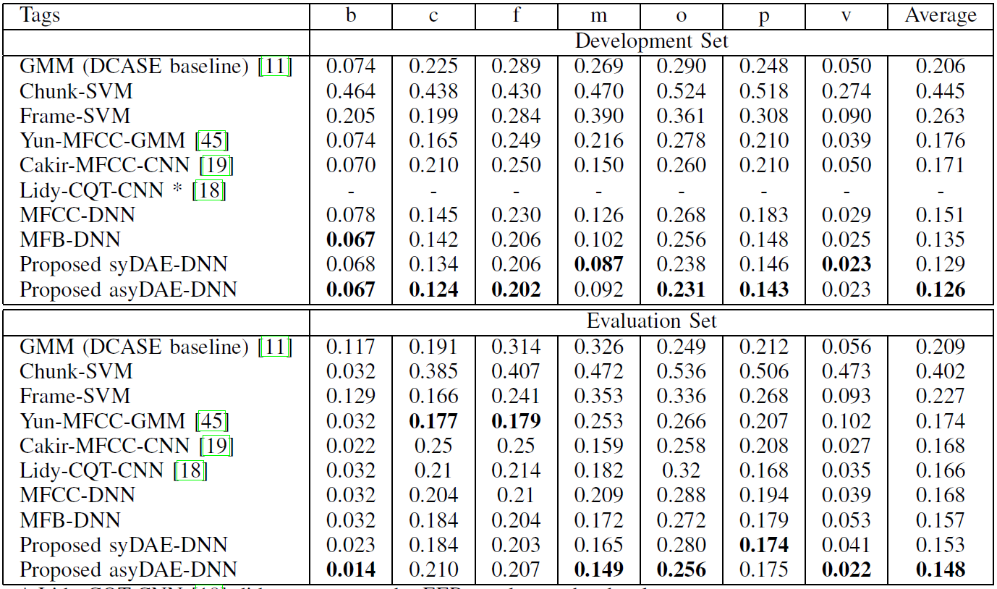
Promising EER performance for asyDAE

Slide 40
Using Class Hierarchy

Slide 41
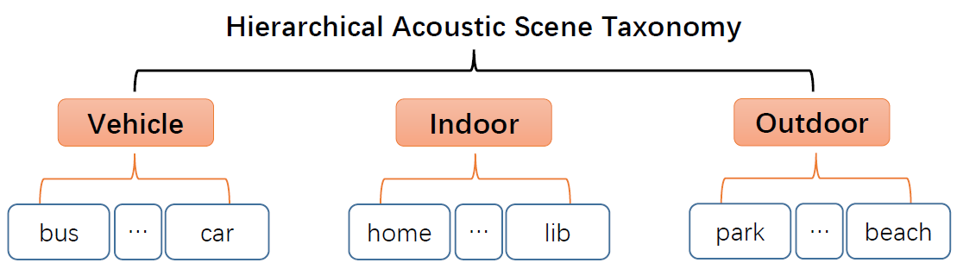
Hierachical Acoustic Scene Taxonomy
Use hierarchy to help train the DNN

Slide 42
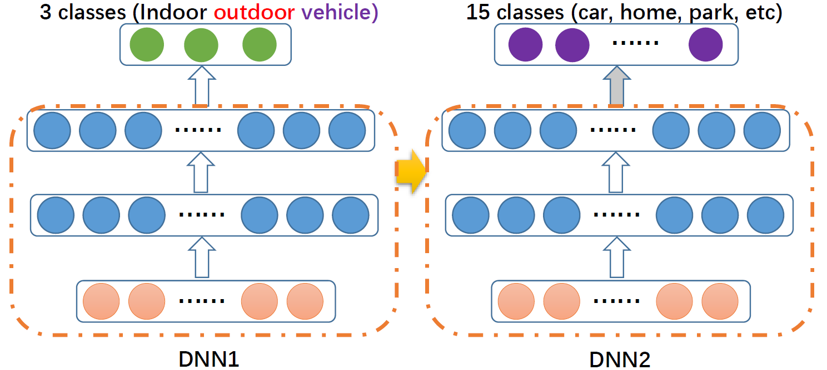
Hierarchical pre-training
Train on “high-level” 3-class problem first
Transfer weights of hidden layers to refined 15-class problem

Slide 43
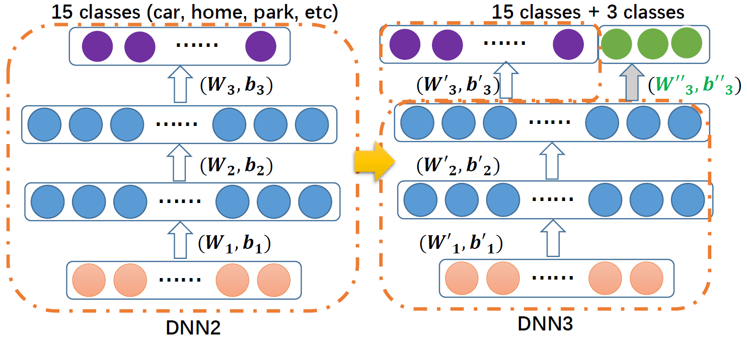
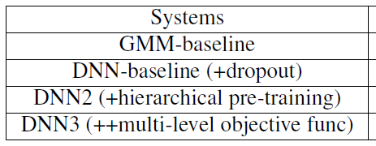
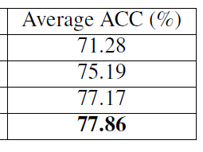
Also: Multi-level objective function
Augment target output with high-level classes
Equivalent task, but likely to change learning dynamics

Slide 44
Using Spatial Features

Slide 45
Using spatial features
Some datesets include spatial information
E.g. CHiME-Home data recorded by binaural Head-and-Torso model in domestic home
Direction of arrival can help distinguish e.g.
Kitchen sounds (from kitchen direction)
TV/Video sounds (from sitting room direction)

Slide 46
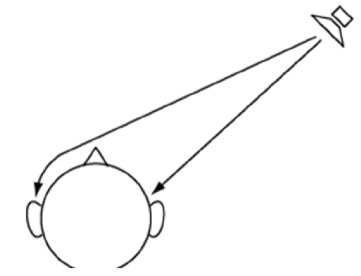
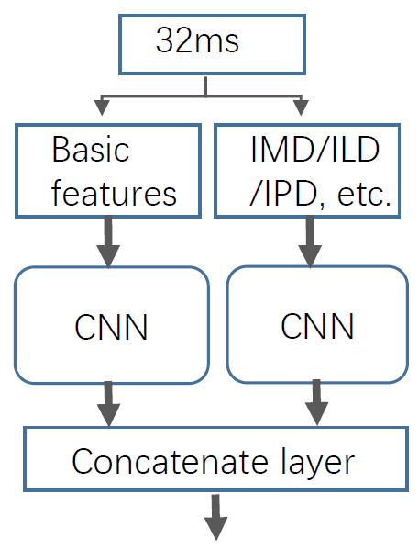
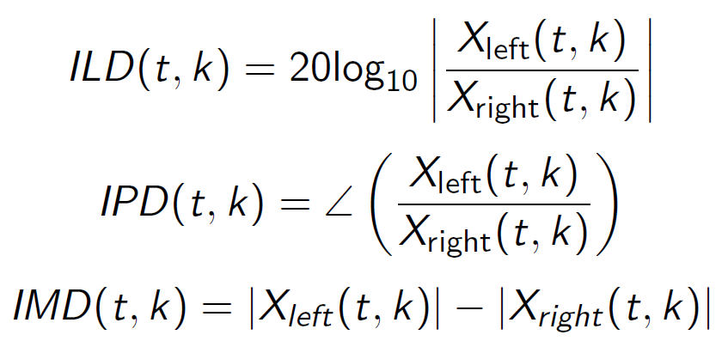
Spatial Features
Spatial features investigated:
interaural phase / time difference (IPD / ITD)
interaural level diff (ILD)
interaural magnitude diff (IMD)
Fusion layer for spatial features

Slide 47
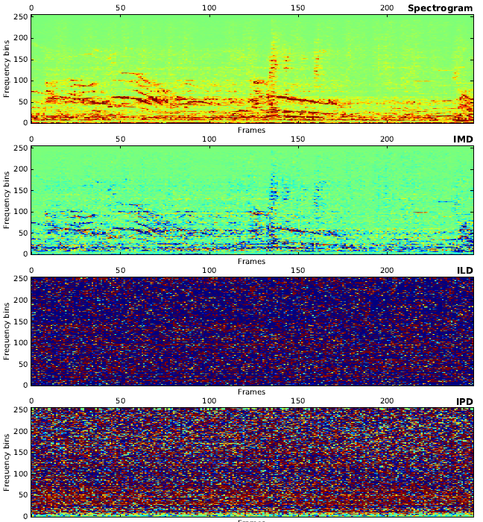
Visualising spatial features
Spectrogram
IMD
ILD
ILD & IPD may be affected by reverberation in room
recording
IPD

Slide 48
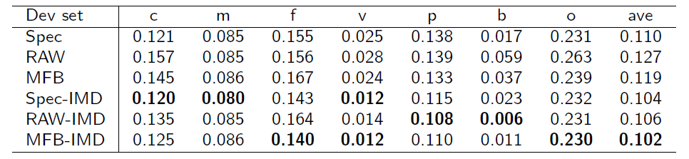
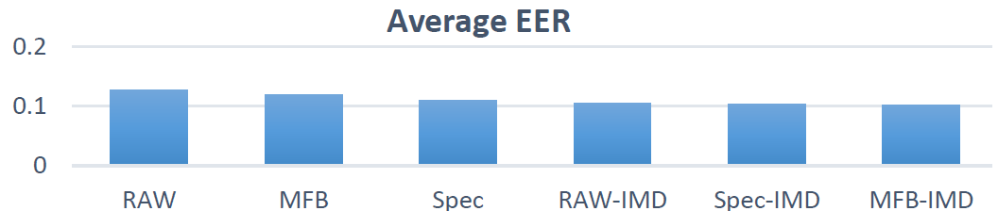
Effect of Interaural magnitude difference (IMD)
DCASE 2016 Audio Tagging Task - Development Set Equal Error Rate (EER) Spectrogram (Spec), Raw waveform (RAW), Mel filter bank (MFB) Result: Adding IMD improves performance
Results on

Slide 49
Weakly Labelled Data

Slide 50
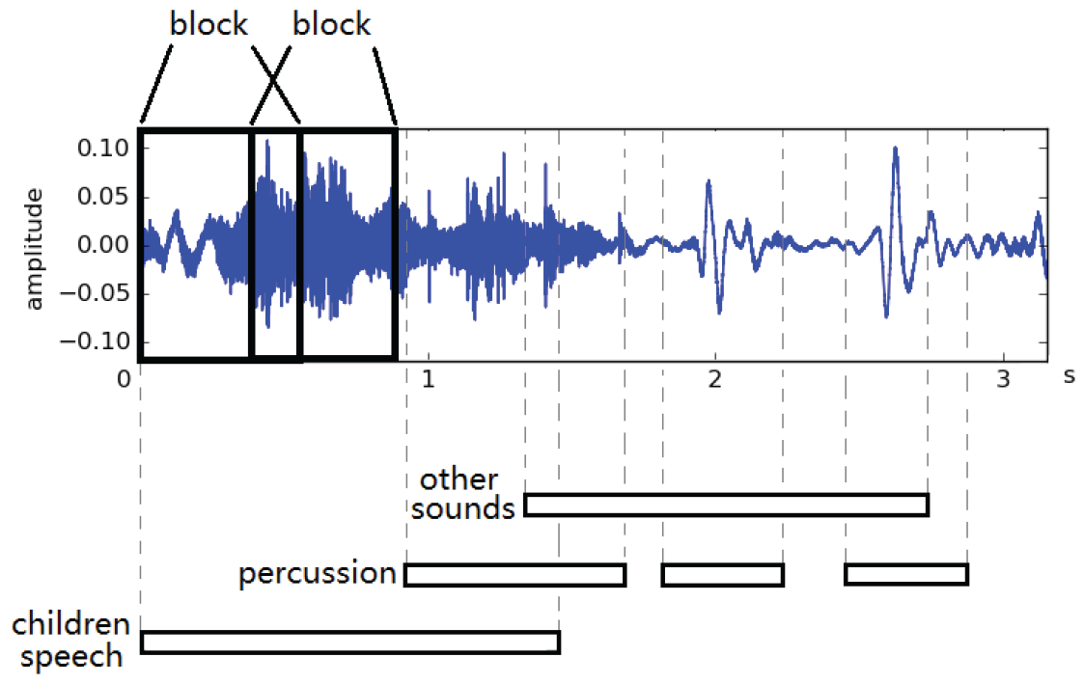
Weakly labelled data
With: Qiuqiang Kong, Yong Xu, Wenwu Wang
Weak labels - class for whole chunk
“Class X is in here somewhere”
Compare: Strong labels – class for each frame/block
“Class X is here and here”

Slide 51
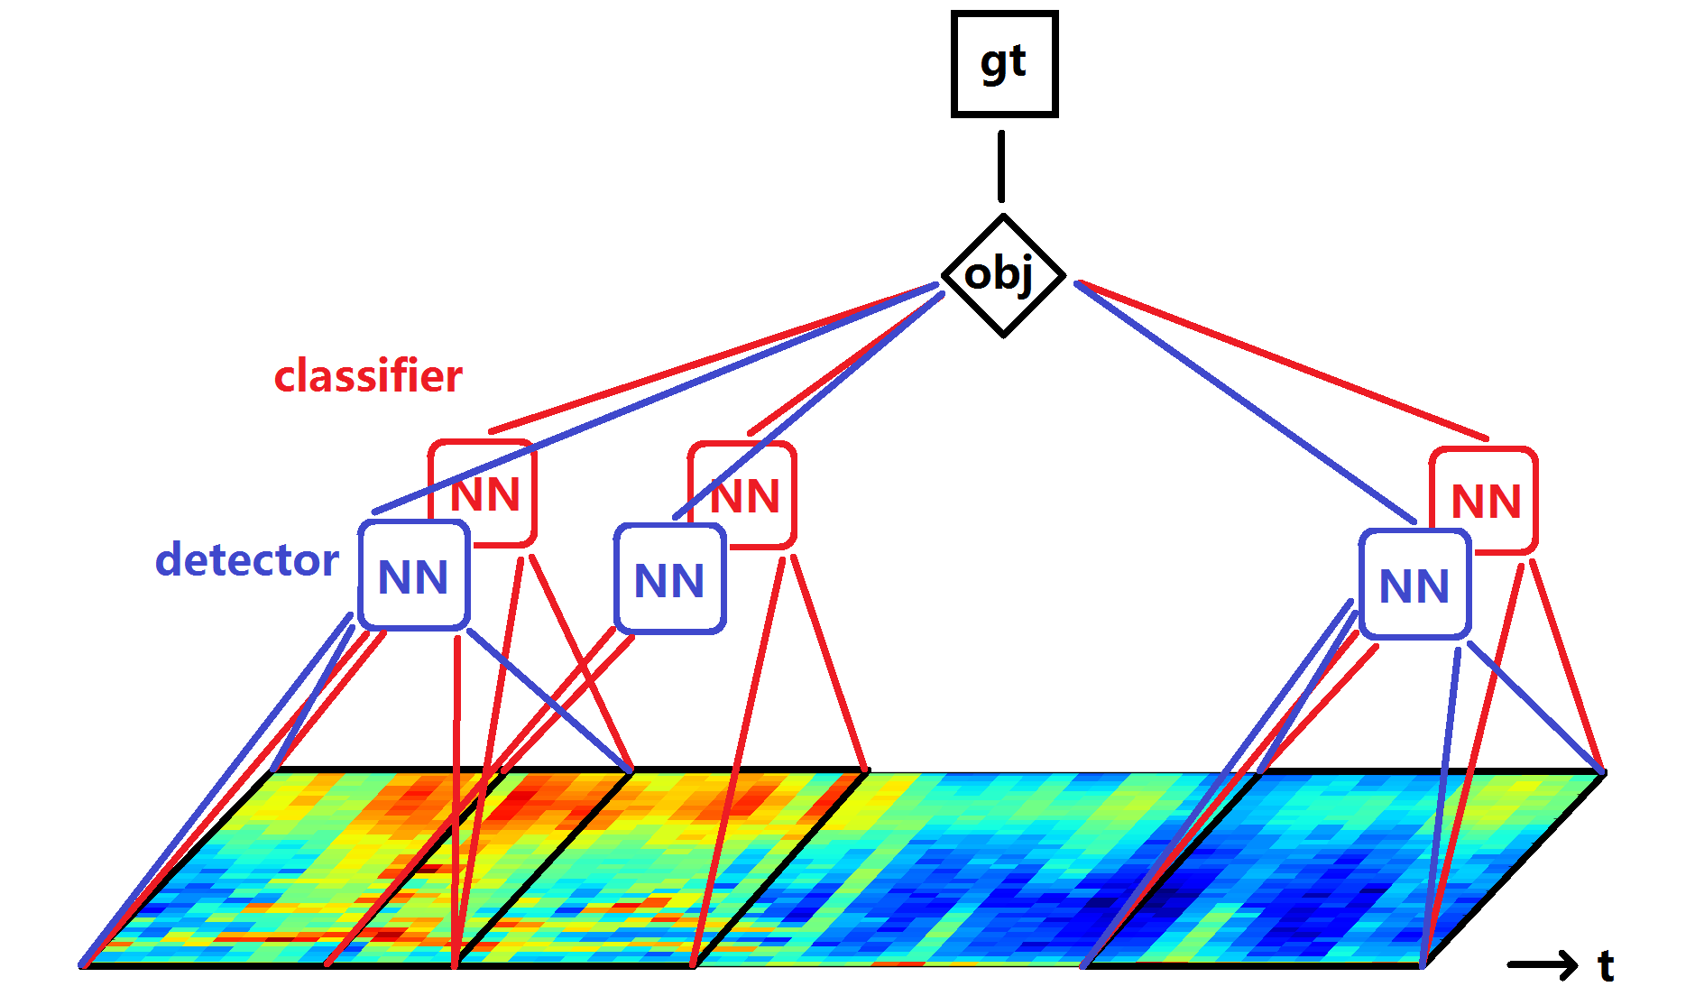
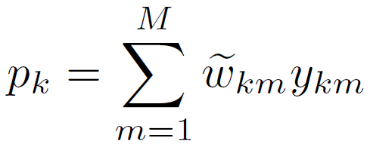
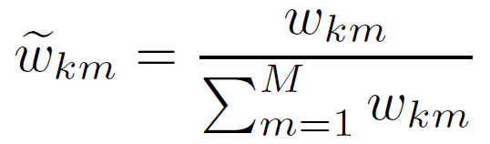
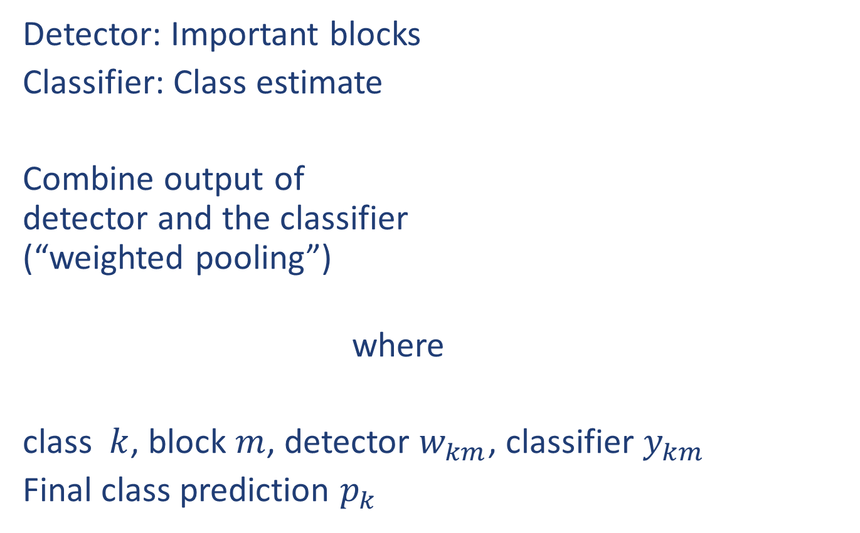
Joint detection and classification (JDC) model
Detector: Important blocks
Classifier: Class estimate
Combine output of detector and the classifier (“weighted pooling”)
where
class $k$, block $m$, detector $w_{km}$, classifier $y_{km}$
Final class prediction $p_{k}$
[Kong, Xu, Wang, P, ICASSP 2017]

Slide 52
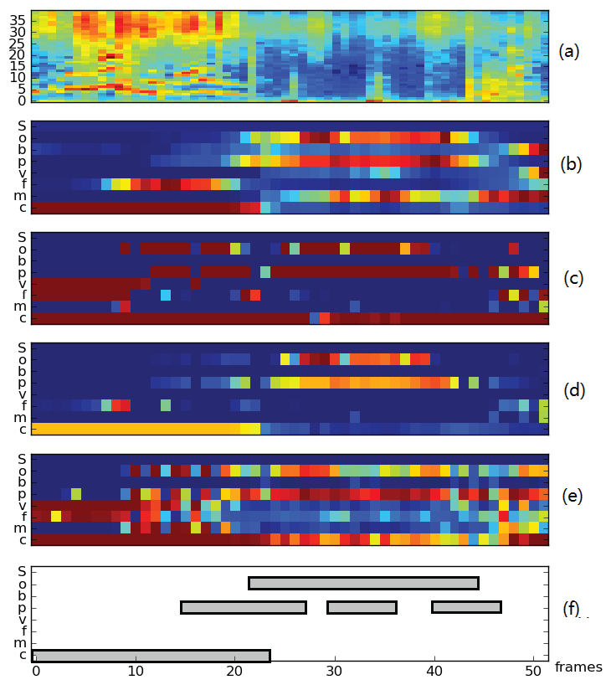
Joint Detection-Classification: Results
Mel Spectrogram
JDC Detector output
JDC Classifier output
JDC Detector-Classifier output
Compare: Back-of-Blocks model
Labels
Equal Error Rate for method: | EER (dev. data) | EER (test data)
MFCC + GMM (baseline) | 21.3% | 20.9%
Bag of blocks | 16.7% | 19.0%
JDC | 17.3% | 16.9%

Slide 53



JDC for Bird Audio Detection
[Kong, Xu, P, EUSIPCO 2017]
Mel Spectrogram
Comparable to mean pooling
Indicates frames for classifier focus of attention
Classifier feature maps (before global pooling layer)
Detector output

Slide 54


DCASE 2017 Audio Tagging (Task 4a)
Log mel spectrograms
+ Convolutional recurrent neural networks (CRNNs)
+ Mini-batch data balancing in
+ Attention using Gated Linear Units (GLUs)
+ Fusion of systems
DCASE 2017 Audio Tagging: -> Best F1 score

Slide 55
Privacy: Are you devices listening to you?
With: Jason Nurse

Slide 56





More and more devices you can talk to…
Apple Siri
Google Home (“OK Google”)
Microsoft
Cortana
Amazon Echo (“Alexa”)
Images: CC-BY-SA-3.0 Frmorrison at English Wikipedia; CC BY-SA 4.0 Daniel.Cardenas; Apple Press Release; Microsoft product screenshot, used with permission from Microsoft.
Apple HomePod

Slide 57
Where does the data go?
“How far is London?”
“How far is London?”
“How far is London?”
“What’s the weather?”
“OK Google, What’s the weather?”
“What’s the time?”
“Who is Prime Minister?”
“OK Google, What’s the weather?”
“What’s the time?”
“Who is Prime Minister?”
“What’s the time?”
“Who is Prime Minister?”
“What’s the weather?”
“What’s the weather?”
“What’s the weather?”
Internet
“30 degrees
and sunny”
30 degrees and sunny

Slide 58


But: It doesn’t just respond to you…
Notes:
Usage issues and accidents in device usage – perfect example is of the 6 year old that ordered a £140 doll house and box of cookies from Alexa. (link: http://www.foxnews.com/tech/2017/01/03/6-year-old-accidentally-orders-high-end-treats-with-amazons-alexa.html)
Issues become more profound as tv news reports cause more Alexa devices to be activated and more doll houses purchased! (link: http://www.cbsnews.com/news/tv-news-anchors-report-accidentally-sets-off-viewers-amazons-echo-dots/)
Companies coming up with clever ways to exploit these devices presence in our homes, e.g., Burger Kings new advert (link: https://www.youtube.com/watch?v=U_O54le4__I)

Slide 59

Other ways to misuse “my” voice assistant…
Notes:
Usage issues and accidents in device usage – perfect example is of the 6 year old that ordered a £140 doll house and box of cookies from Alexa. (link: http://www.foxnews.com/tech/2017/01/03/6-year-old-accidentally-orders-high-end-treats-with-amazons-alexa.html)
Issues become more profound as tv news reports cause more Alexa devices to be activated and more doll houses purchased! (link: http://www.cbsnews.com/news/tv-news-anchors-report-accidentally-sets-off-viewers-amazons-echo-dots/)
Companies coming up with clever ways to exploit these devices presence in our homes, e.g., Burger Kings new advert (link: https://www.youtube.com/watch?v=U_O54le4__I)

Slide 60


Privacy impact if data is shared / hacked?
Notes:
Interesting case in the US where someone’s smart home is being used against them. Specifically the police have sought to get access to voice recordings from Amazon in a murder investigation (link: https://techcrunch.com/2017/03/12/alexa-privacy/)
While we hope companies will keep our data safe, what if they don’t and are hacked – CloudPets is a good example of this (link: http://www.huffingtonpost.com.au/2017/02/28/millions-of-private-messages-between-parents-and-kids-hacked-in/)

Slide 61
Conclusions

Slide 62





Recognizing Everyday Sounds
Now:
Smart Homes:
Glass break
Smoke alarms, …
Birdsong
Future?
Smart Cities:
Traffic sounds, …
Listening out for the elderly at home?
Images: Warbl app; Audio Analytic; University of Surrey; Surrey and Borders NHS Trust ‘Internet of Things’ Test Bed

Slide 63

Conclusions
Need more data – data challenges can help
This year: DCASE 2017 challenge and workshop
Computational cost may be important
Can use Deep Learning
Many issues to consider: Class structure, weak labels, …
How handle privacy & security issues?
Just published: Virtanen, Plumbley, Ellis (Eds)

